Slide 1
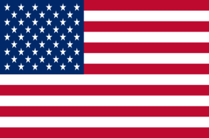
World War II: The Pacific Theater

Slide 2
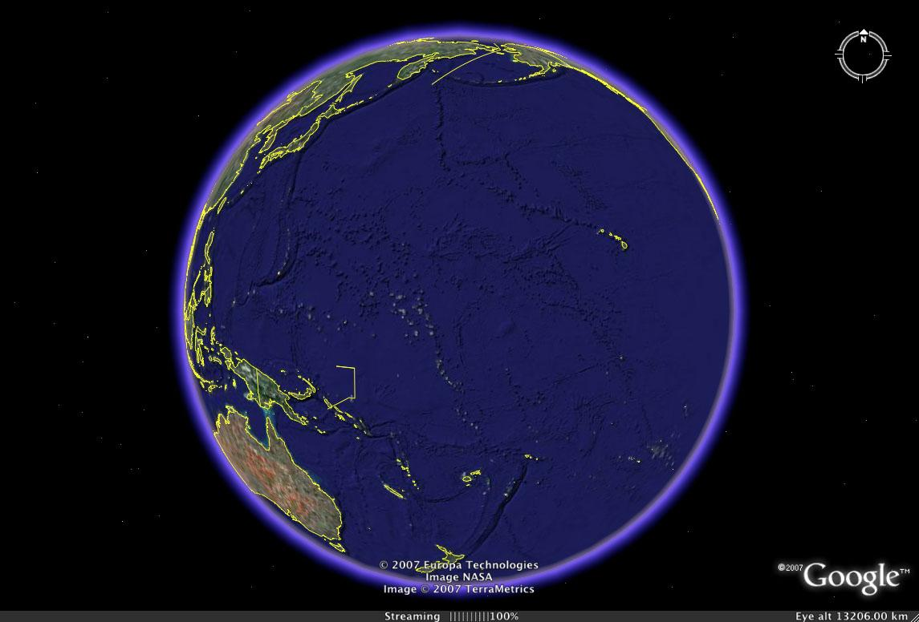
The Pacific Ocean
Japan
Canada
China
USA
SE Asia
Australia

Slide 3
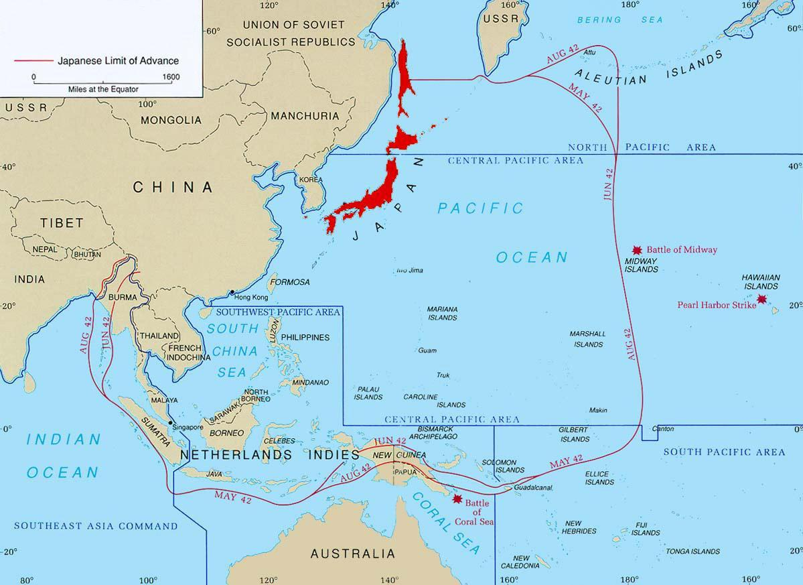
Prewar

Slide 4
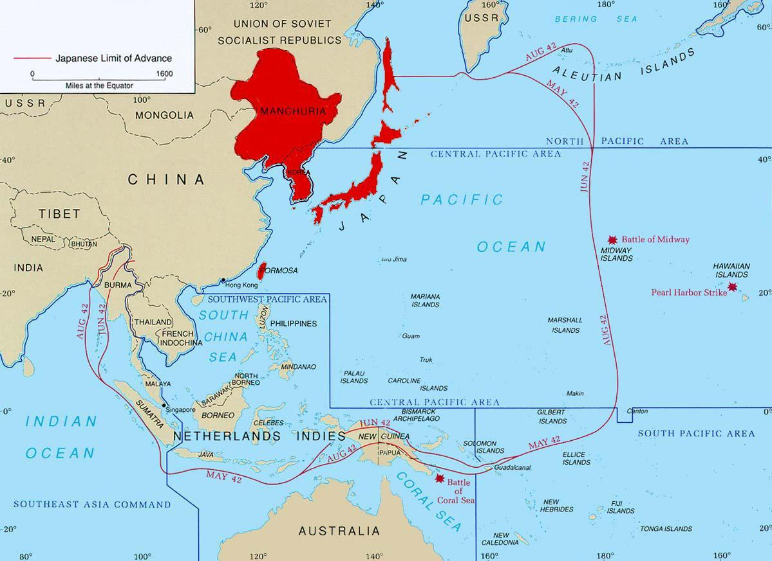
1932

Slide 5
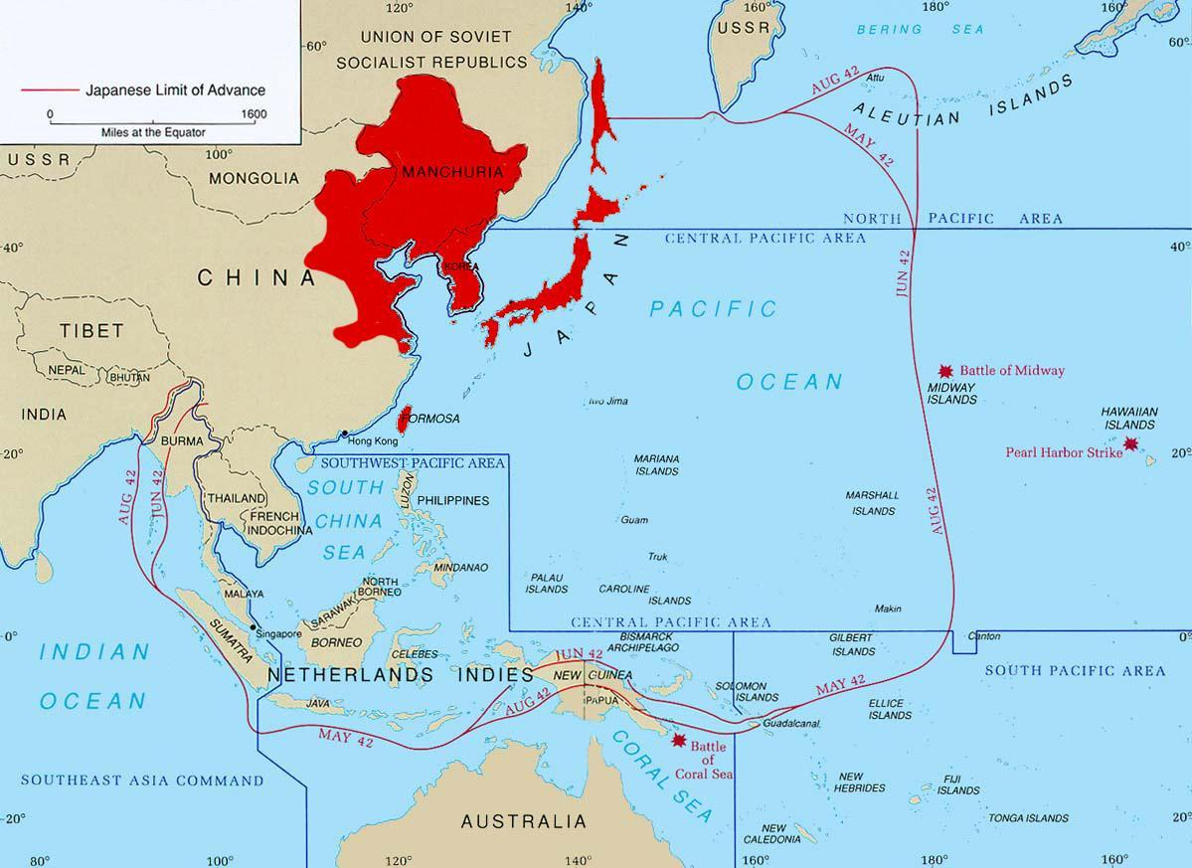
1937
C
B
A
D
“ABCD Encirclement”

Slide 6
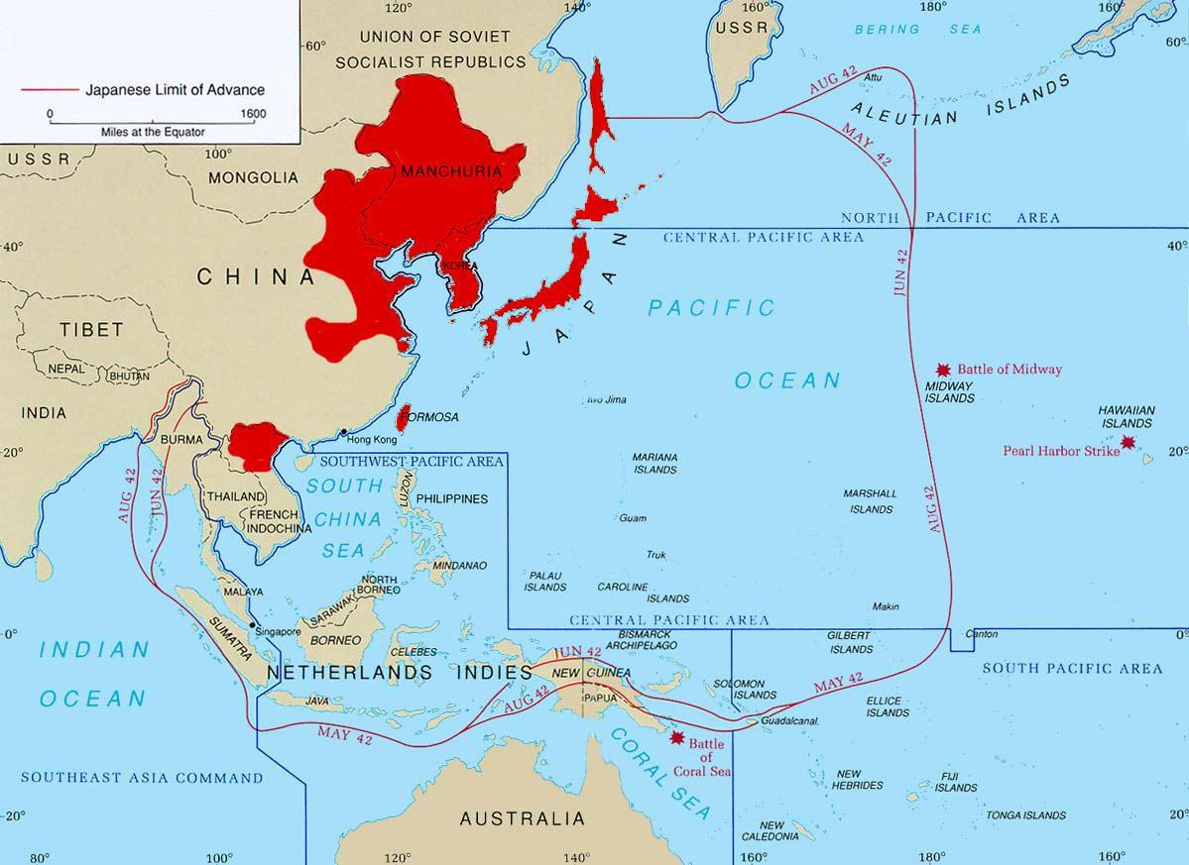
1940

Slide 7
1941
Dec 8/7 1941
Notes:
Dec 8/7 1941 (simultaneous, but Int’l date line skews date)
Attacks on British Territory (Hong Kong) and American Territory (Pearl Harbour)

Slide 8
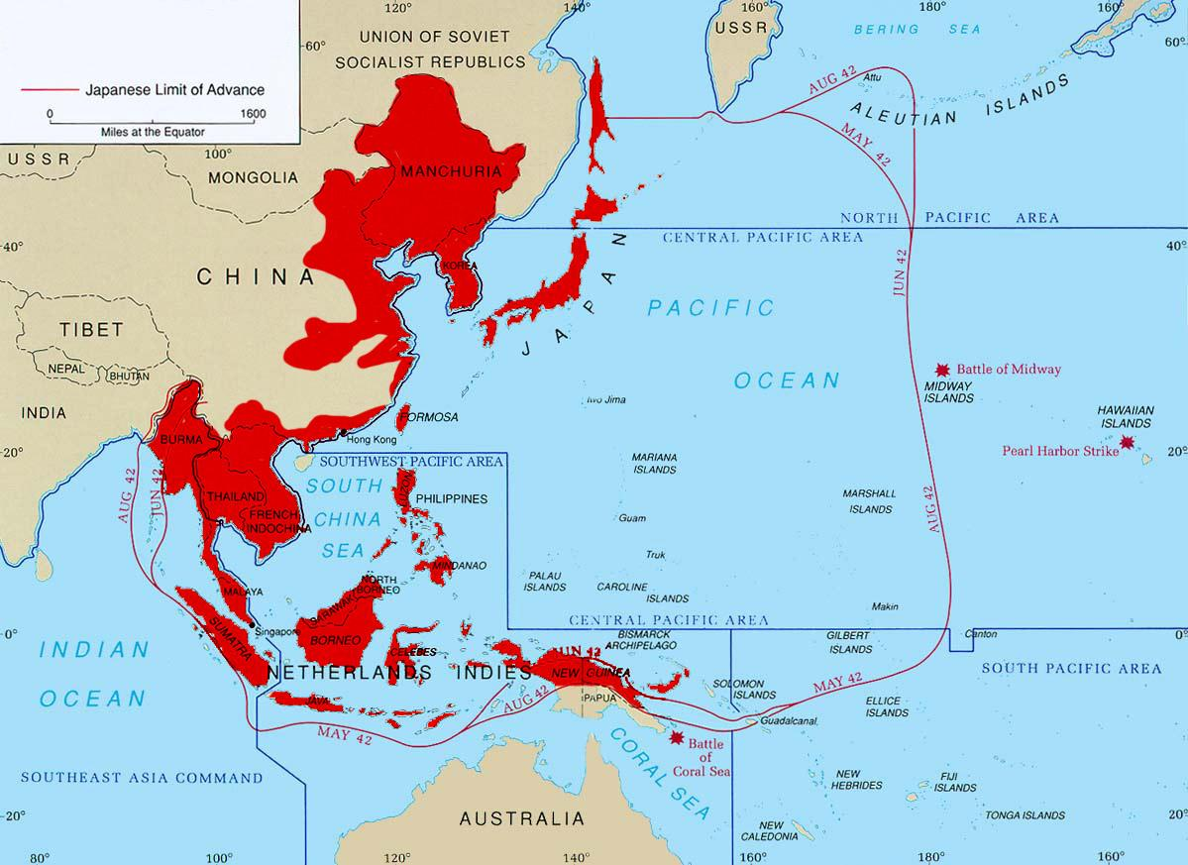
1942

Slide 9
See Interactive Map

Slide 10
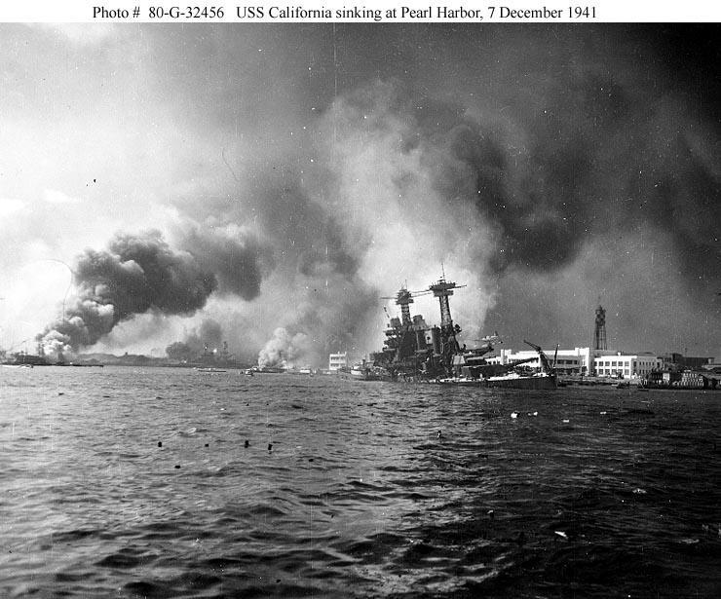
Attack on Pearl Harbour
Dec 7, 1941. “A day that will live in infamy”

Slide 11
U.S. Declares War
Monday Dec. 8, 1941
Roosevelt gives speech: “This day will live in infamy”
Who declares war?
Thousands of men line up for recruitment
America joins the fight in Europe and is ready to fight Japan

Slide 12
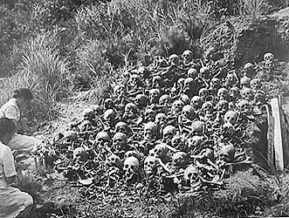
Japanese Atrocities

Slide 13
Kamikaze.
Kamikaze- ‘Divine Wind’.
It became obvious that the US possessed more and better war technology
In desperation Japan ordered her young men to beat the enemy by flying bombs into the enemy (and dying in the process)
These suicide bombers flew planes, or manned suicide torpedoes.

Slide 14
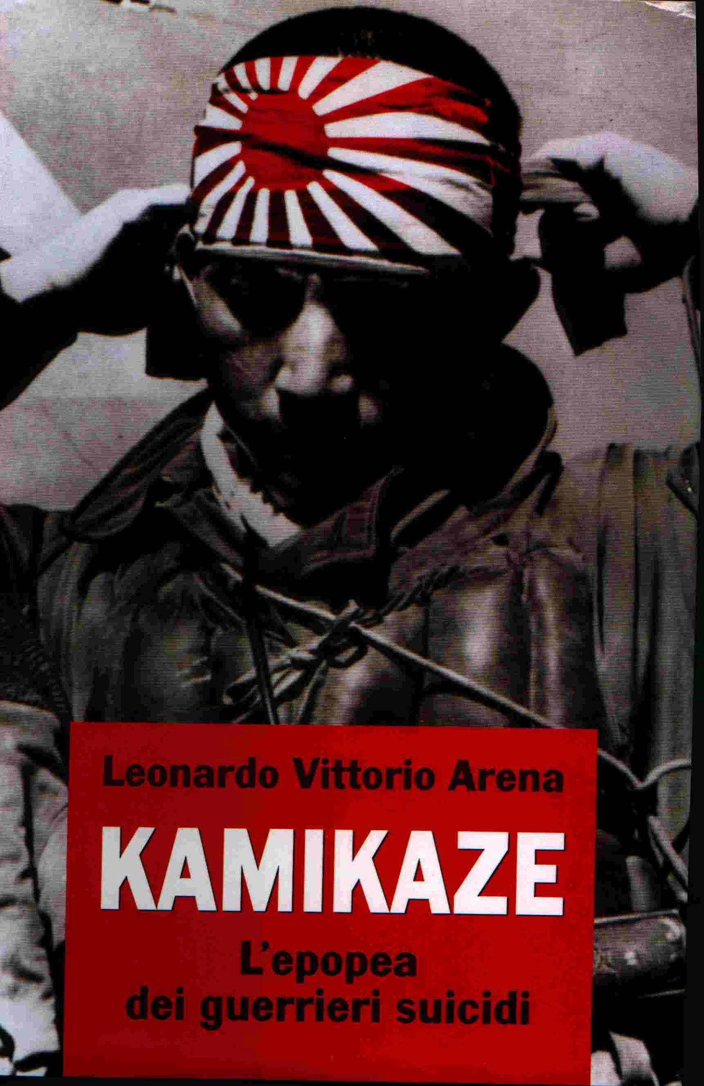
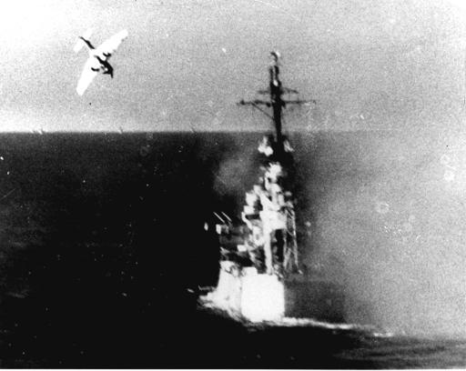

Slide 15
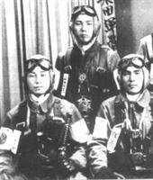

Slide 16
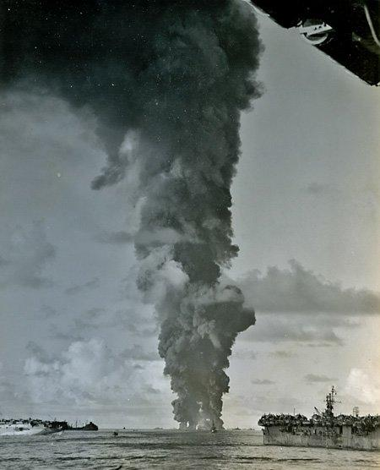
US ships ablaze after kamikaze attacks

Slide 17
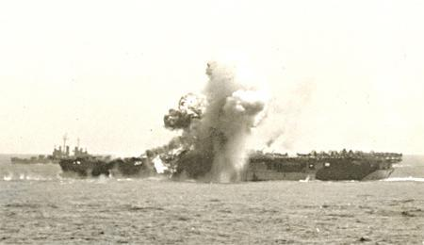
Another Kamikase hit on a US carrier.
A US sailor commented ‘the fight might be tough on land, but you can’t dig foxholes in the sea’!
What do you think he meant?

Slide 18
Battaan Death March
Japanese take Bataan Peninsula
Many American and Filipino forced to march to camps
Limited food and water
Extremely long march
Many died of weakness--if one fell out of the row, more than likely shot dead

Slide 19
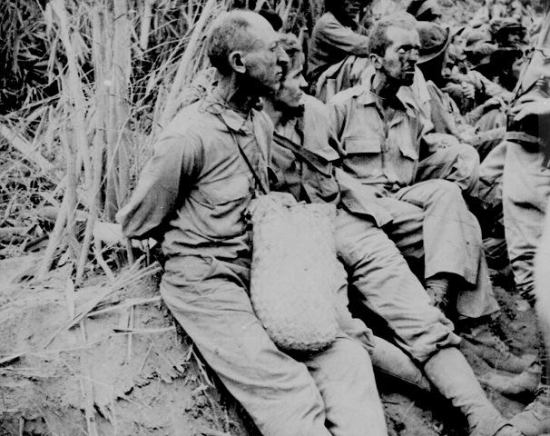
Bataan Death March April 1942
12,000 Americans walked 60 miles to a POW camp
No food or water
5,000 died

Slide 20
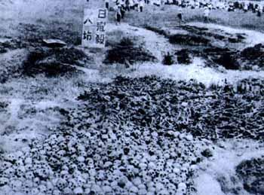
The Rape of Nanking Dec 1942-Feb 1943.
The Japanese army were allowed to run riot.
Up to 300,000 civilian Chinese deaths
1,000 rapes a day
Hospital patients tortured.
Soldiers bayonetted and shot people at will.

Slide 21
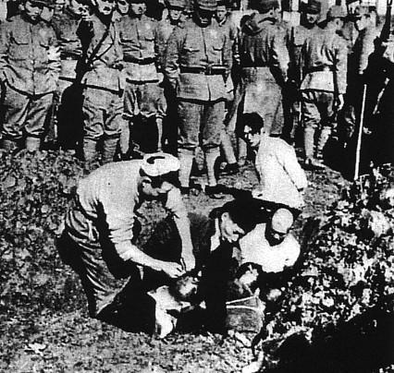
Five Chinese civilians being buried alive.

Slide 22
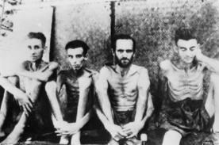
American POWs

Slide 23
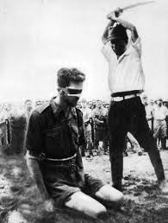
American POW seconds before being executed

Slide 24
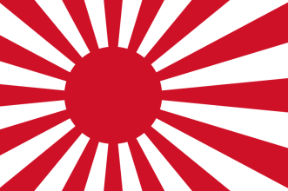
The Battle of Midway
US forces:
3 carriers, 1 lost
~50 support ships, 1 destroyer lost
360 aircraft, 98 lost
307 dead
Japanese forces:
4 carriers, 4 lost
7 battleships, 0 lost
~150 support ships, 1 cruiser lost
264 aircraft, 228 lost
3058 dead
Notes:
The four carriers: Hiryu, Soryu, Akagi and Kaga represented Japan’s only heavy carriers at the time. Losing all four was a crippling blow.
Additionally, the loss of the elite pilots would be felt deeply, as their combat skills and ability to train new pilots would be sorely missed in years to come.

Slide 25
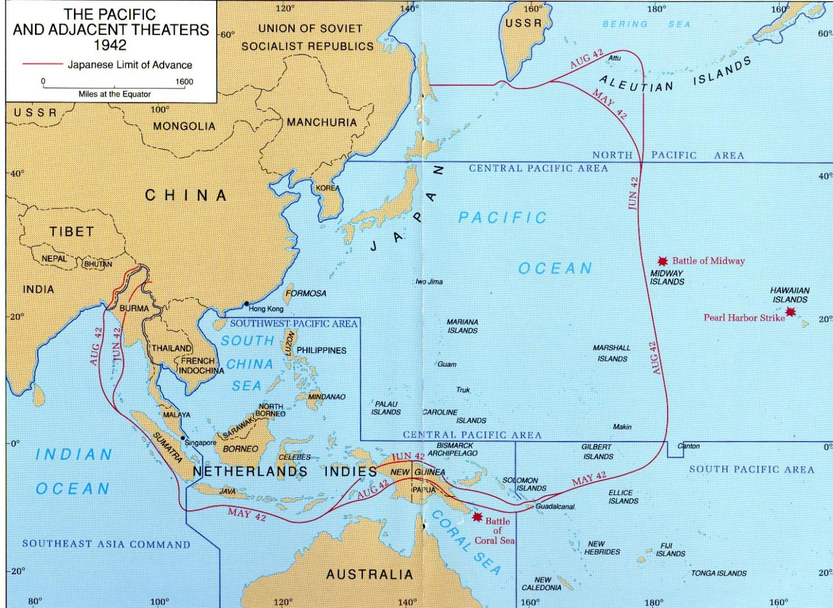

Slide 26
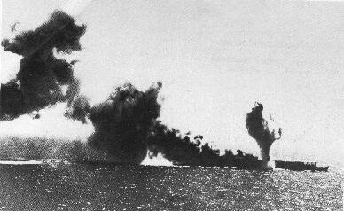
Midway Island. May 1942
US aircraft carriers outclass the Japanese carriers and catch them off guard.
The Japanese navy loses 4 of it precious aircraft carriers in this one battle.
Japan cannot replace the loss quickly- unlike the US. It is the turning point of the war.
A Japanese carrier on fire and sinking.

Slide 27
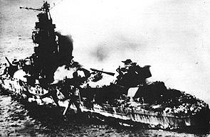
Mighty Japanese battleships are pounded to pieces by US carrier planes. They are obsolete.

Slide 28
Midway Outcomes/Impacts
Destroys 4 Japanese carriers (those that had attacked Pearl Harbor) – US only loses 1
Japan loses 100+ trained pilots
Postpones Japanese plans to take New Caledonia, Fiji and Samoa
US & Japanese now equal in Naval power in the Pacific
Considered decisive in halting the Japanese offensive - Allies now on the offensive, too

Slide 29
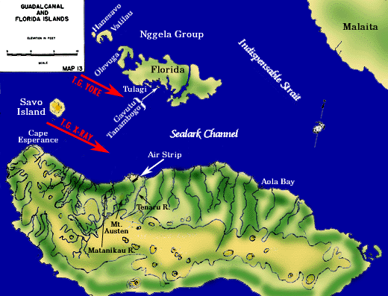
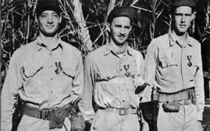
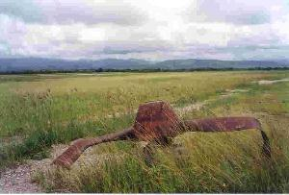
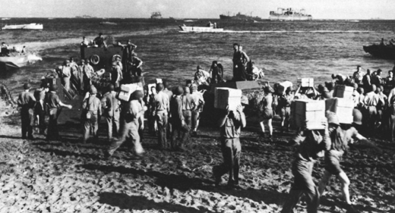
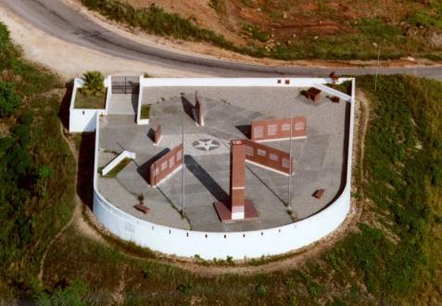
Guadalcanal—Aug. 42
Who: US vs. Japan
Where: Island near Australia—
one of Solomon Islands
What: One of the most vicious campaigns
Japanese put up a fierce resistance
US has superior air and naval power
Results:
First time US land troops defeat Japanese
Americans are able to secure the island

Slide 30
Guadacanal
Aug. 1942
South Pacific
Battle that the U.S.S. Yorktown sank*
Stopped the Japanese
Began island hopping campaign
Secures most of the far South Pacific

Slide 31
Island Hopping
A term used to describe the fighting in the Pacific
U.S. and Japan would go from island to island fighting for control
Japan controlled most of the islands in the Pacific
U.S. picked strategic islands to fight for--Why?

Slide 32
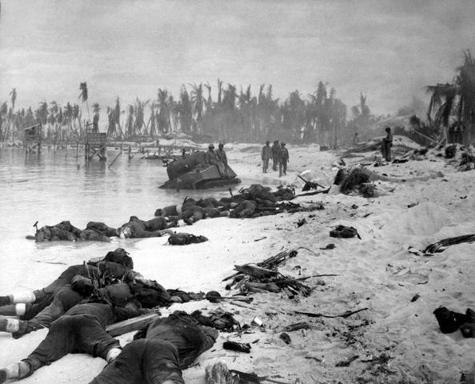
Tarawa atoll.
Despite battleships the Japanese were masters of defence.
US marine casualties were horrendous at every island attacked.
Japanese defenders inevitably fought to the death.

Slide 34
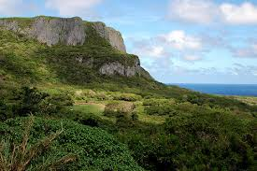
Saipan “Suicide Cliff”

Slide 35
The Battle of Okinawa
Largest amphibious invasion of the Pacific campaign
Most guns, ships, supplies, bombs dropped, troops ashore compared with any other Pacific battle
Bloodiest Pacific battle
Kamikazes make significant dent in US Pacific fleet
Japanese soldiers enacted forced “suicides”

Slide 36
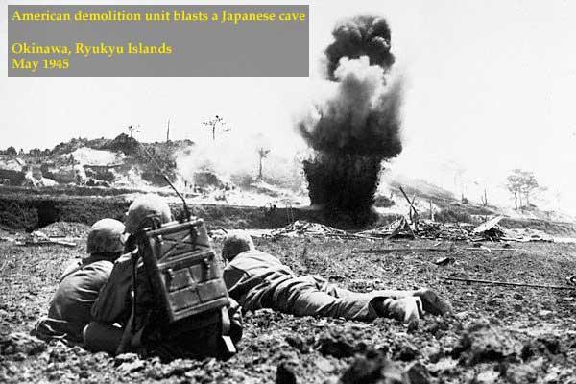
Okinawa Island - May 1945
This island is within bomber range of Japan. If it falls Japan will, at last, be vulnerable.

Slide 37
Kamikase attacks reach their peak.
Even the Yamato battleship is sent on a suicide mission (and is sunk)

Slide 38
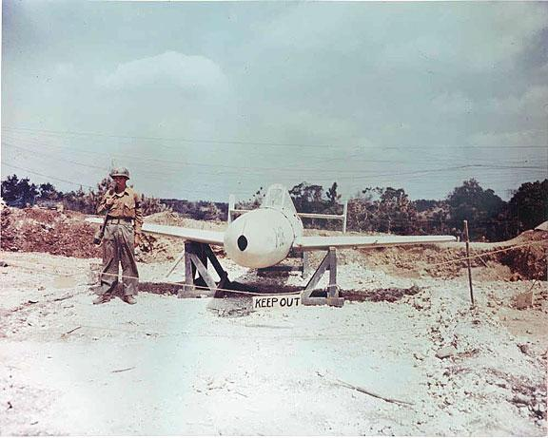
The ‘Ohka’
This is an unused Japanese suicide rocket bomb found on Okinawa. There were no more Japanese planes to launch it.

Slide 39
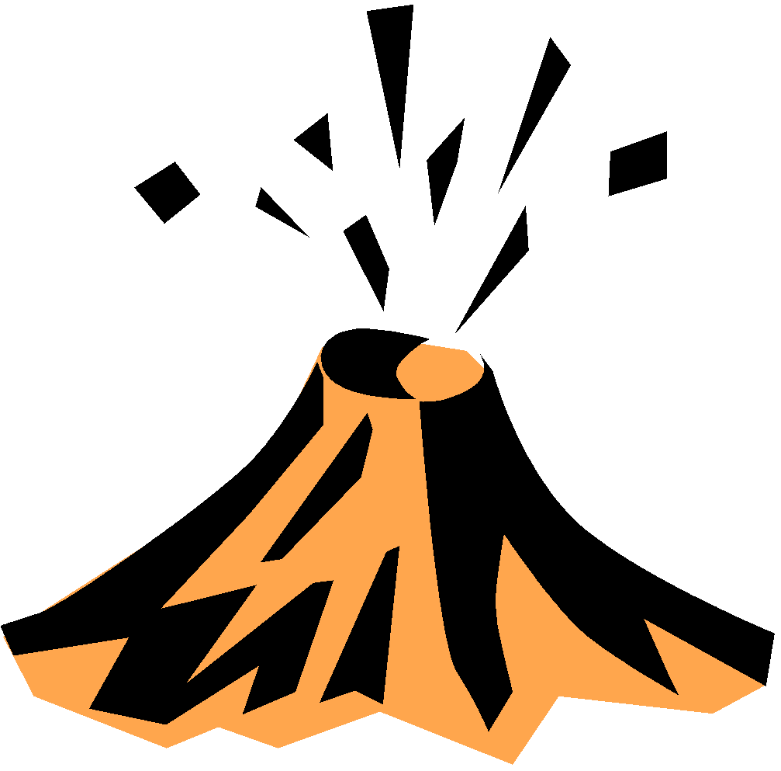
Iwo Jima
February-March 1945
Island off the coast of Japan—Japanese soil
Longest sustained aerial offensive of the war
More marines sent than in any other battle
100,000 men fighting on an island the 1/3 the size of Manhattan
Japanese fought from below ground—Allies rarely saw a soldier
The battle was won inch-by-inch
Volcanic island deeply entrenched

Slide 40
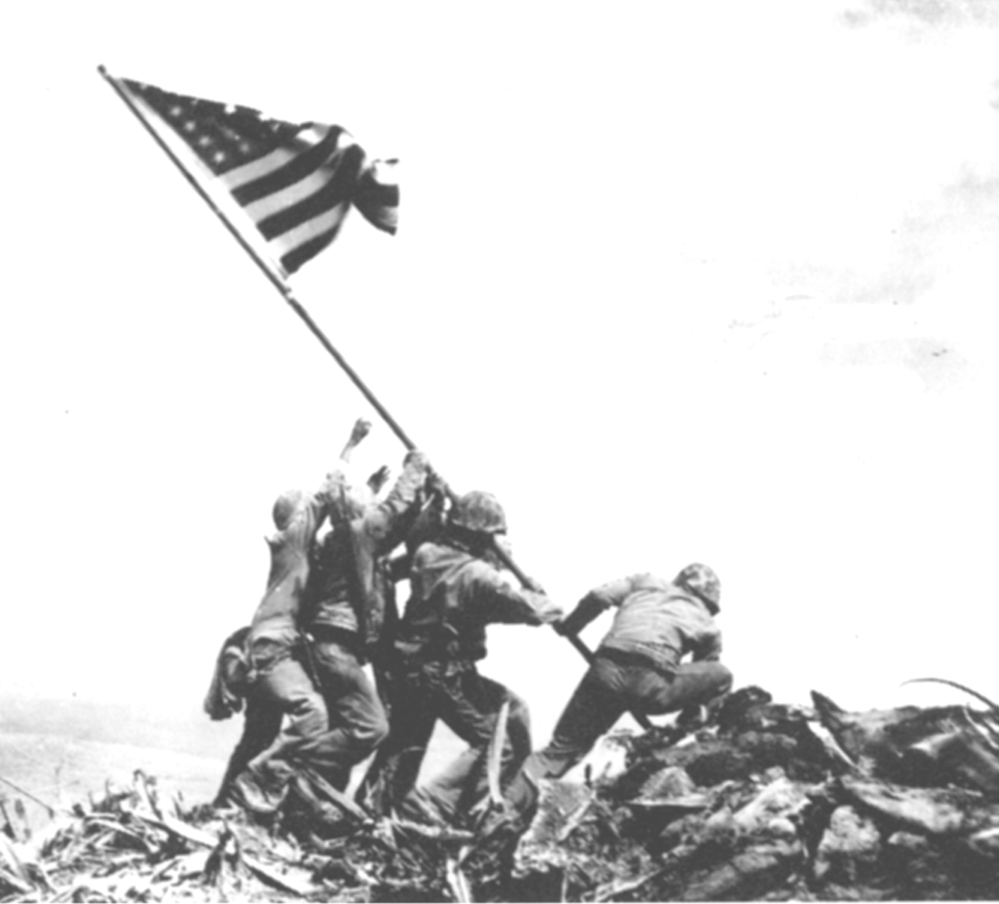
Iwo Jima Feb 1945
Tiny – 4.5 mi long x 2.5 mi wide
Tactically important – 2 airstrips
Japanese could use them as base for fighters
Americans could use them as emergency landing bases; bases for US fighter planes

Slide 41
US Tactics – Iwo Jima
22,000 Japanese soldiers dig in building defenses esp. in north
3 days of bombings before amphibious landing
Bombing only served to churn up beach– Japanese had more hiding places, perfect for snipers – was able to hold up the US advance
Over 2400 US casualties on day 1
US Marines: 6,891 killed, 18,070 wounded
22,000 Japanese, only 212 taken prisoner (Keylor says 1000)
http://www.historylearningsite.co.uk/battle_of_iwo_jima.htm

Slide 42
Impacts of Iwo Jima
Japanese would not retreat – fight to the death
Influences decision to use atomic weapons on Hiroshima & Nagasaki

Slide 43
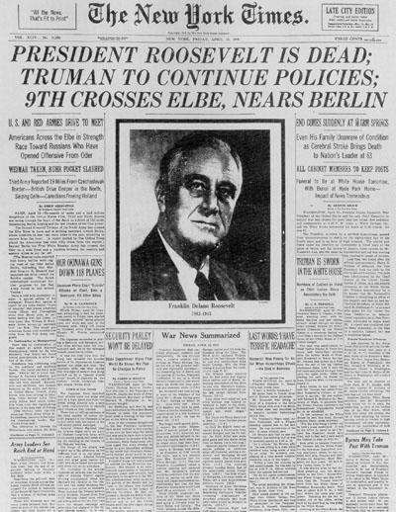

Slide 44
Manhattan Project
A completely secret plan to develop the atom bomb
The Vice-President did not even know of the project
Where did the research take place?
Where was the testing place and other important info taken to?

Slide 45
Hiroshima/Nagasaki
Aug. 6, 1945 the first atomic weapon was used
80,000 people died thousands more injured
Used to force surrender--Japan refused
Aug. 9, 1945 Nagasaki bombed
Japan finally realizes they need to surrender

Slide 46
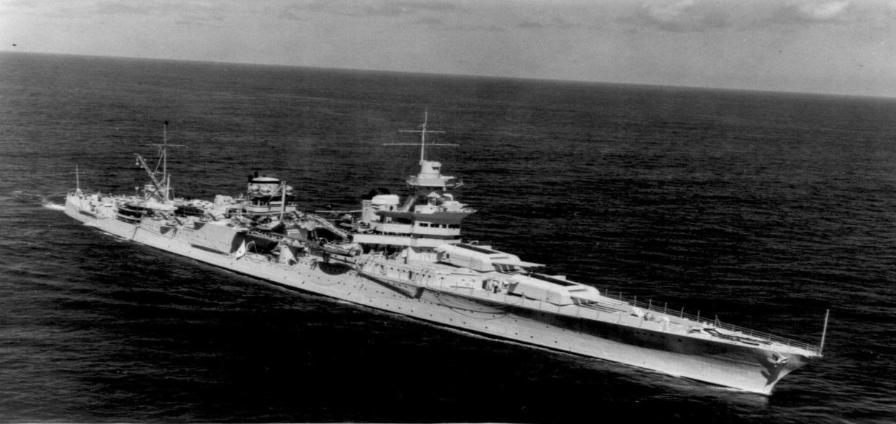
The USS Indianapolis
Delivered the first atomic bomb to the US air force in Tinian.
July 30 1945 sunk by Japanese submarine off the Philippines on the way home.
Because of her ‘special mission’ her journey was ‘secret’.
Of 1200 crew, 900 survived the sinking only to find themselves at sea with no rescuers even looking for them.
Sharks were quickly attracted and after 4 days only 300 men were left, mostly terrified out of their minds.
It was the worst US Navy disaster in history.

Slide 47
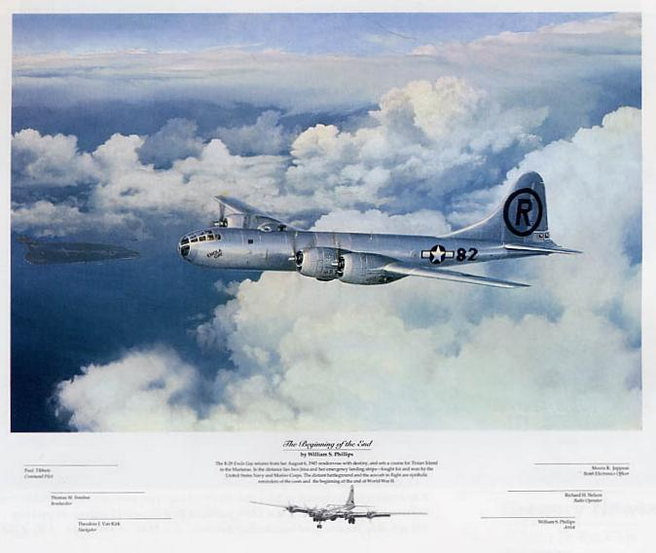
The Enola Gay. The US plane chosen to drop the Atomic bomb on Japan.

Slide 48
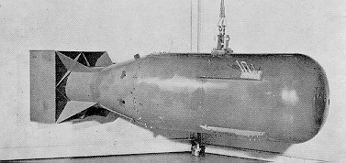
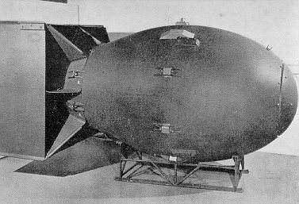
Hiroshima
- 90,000 to 100,000 persons were
killed immediately
- 145,000 persons perish from the
bombing by the end of 1945.
Nagasaki
Little Boy
Leveled Area: 6.7 million square meters Damaged Houses: 18,409 Casualties Killed------73,884 Injured-----74,909 Total------148,793 (Large numbers of people died in the following years from the effects of radioactive poisoning.)
Fat Man

Slide 49
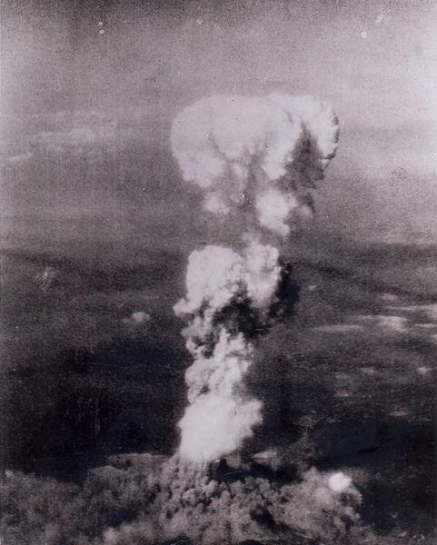
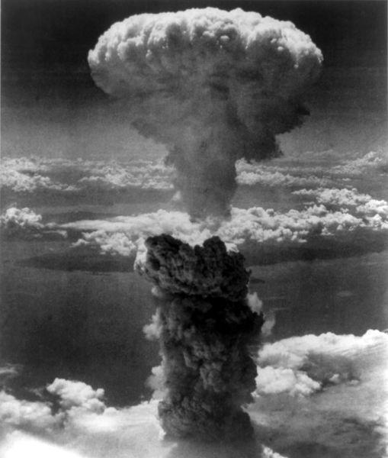
Nuclear Strikes
Aug 6, 1945. Uranium bomb “Little Boy” dropped on Hiroshima, killing 140,000
Aug 9, 1945. Plutonium bomb “Fat Man” dropped on Nagasaki, killing 74,000

Slide 50
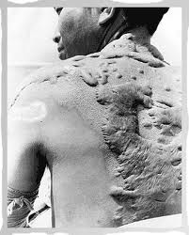
Impact on Japanese civilians

Slide 51
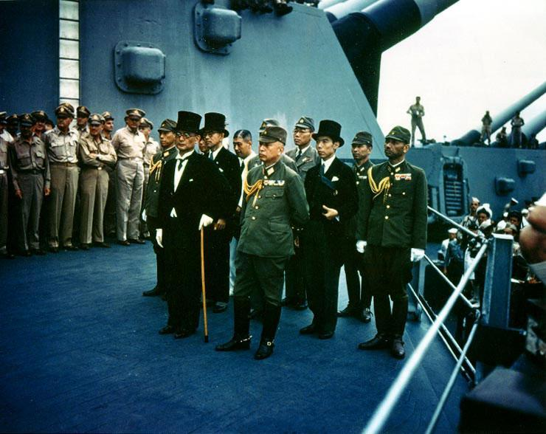
Japan Surrenders
Representatives of Japan’s Foreign Ministry, Army and Navy appear to sign the surrender aboard USS Missouri in Tokyo Bay

Slide 52
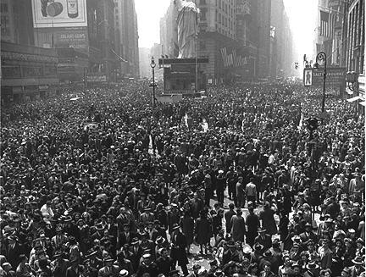
VJ Day (Victory over Japan Day)
The scene in Times Square August 14 1945.
News has just been released that Japan has formally surrendered.
World War two has ended. But the Cold War has already begun….

