Slide 1
Leaders During WWII

Slide 2
The Axis Powers Leaders
Dictators!

Slide 3
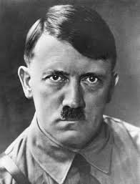
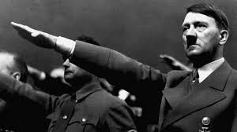
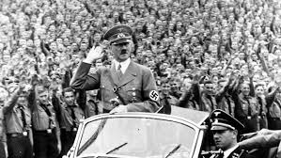
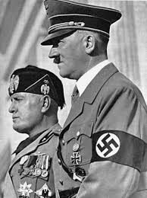

Slide 4
Adolf Hitler
Leader of Germany
1932-1945
Appointed into postion of Chancellor by the Germany leader Hindenburg
When Hindenburg dies Hitler seizes power and becomes the Fuhrer, or leader, of Germany

Slide 5
Adolf Hitler
Becomes Chancellor in 1932 promising to build an Empire that will last a thousand years (aka. “Thousand Year Reich”)
Opponents either disappear to camps or are executed
Controls the press, the schools and the religion of the people
Leader of the Nazi party

Slide 6
Adolf Hitler
Quickly builds an army that will take over Europe peice by peice
Is said to have committed suicide at the end of WWII though no body was ever recovered
His country, Germany, gets split in half for the next forty years after his death

Slide 7
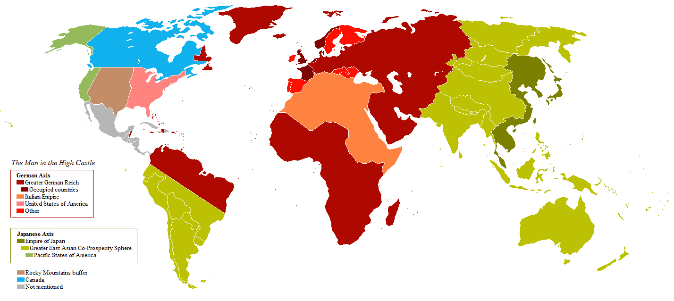

Slide 8
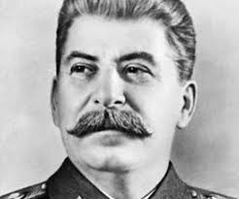

Slide 9
Joseph Stalin
Soviet Union (now known as Russia)
1924-1953

Slide 10
Joseph Stalin
Takes power when previous Soviet leader, Lenin, dies
Becomes communist dictator with total control over the Soviet people
Becomes leader of the military, press and all businesses

Slide 11
Joseph Stalin
Starts as our enemy but ends up as our ally
Becomes our enemy again after WWII
While being our ally in WWII, he kills millions of his own people to keep total control in the Soviet Union
Invades many nations during and after WWII and divides the world during the cold war

Slide 12
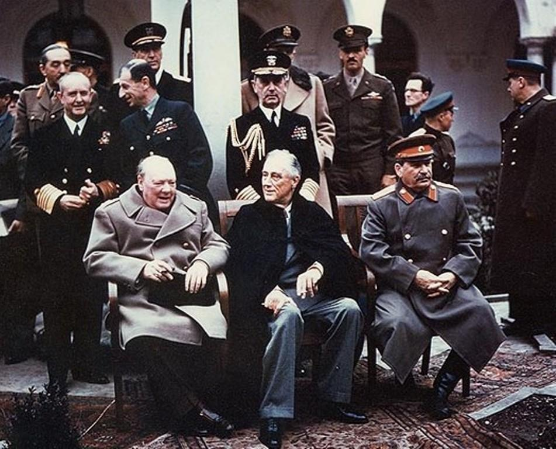
Yalta Conference 1945

Slide 13
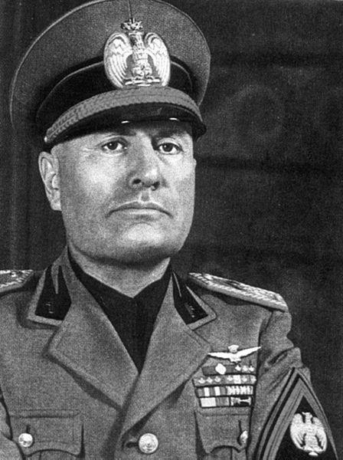
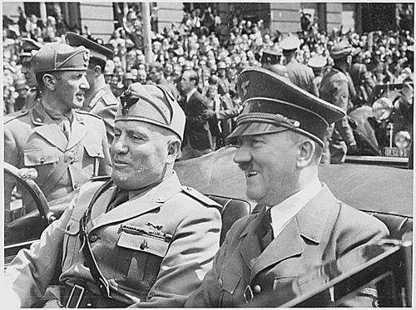

Slide 14
Benito Mussolini
Italy
1922-1945

Slide 15
Benito Mussolini
Led his Fascist Party
Fascists want total authoritarian control over their country to promote extreme nationalism
Nazi’s were one kind of fascists
Helps the Fascist Party take control over Italy adn the Catholic Church

Slide 16
Benito Mussolini
Former journalist and soldier
Attacked Ethiopia and took control over Northern Africa in WWII
Built friendship with Hitler but is really controlled by him
Dies by the hand of his own people after being discovered hiding as a soldier
His body is put on display in Milan

Slide 17
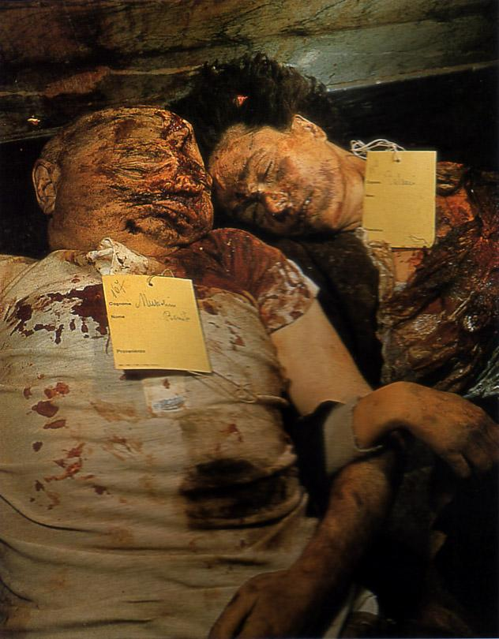

Slide 18
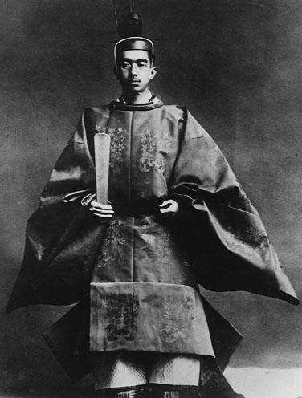

Slide 19
Emperor Hirohito
Japan
1926-1989
Longest ruling Emperor in modern Japan

Slide 20
Emperor Hirohito
Seen as a living God by his people and the military encouraged this belief
Did not control the military but did lead the country
Educated in the west
Was allowed to live and not be tried as a war criminal in exchange for Japan’s surrender

Slide 21
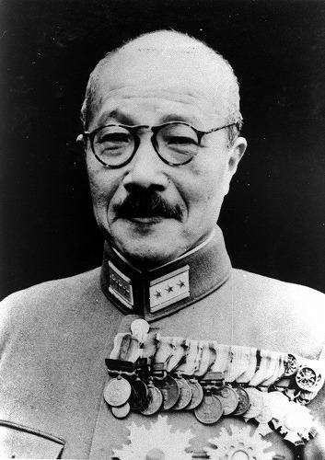

Slide 22
Hideki Tojo
Japan
General of Imperial Japanese Army
Prime Minister of Japan
1941-1945

Slide 23
Hideki Tojo
Directly responsible for Pearl Harbor attack
Responsible for many war atrocities
Arrested at the end of the war and attempts suicide while waiting for his trial
Found guilty of war crimes and hanged in 1948

Slide 24
Tripartite Pact (Berlin Pact)
Alliance between the Axis Powers
Included:
Germany Bulgaria
Italy Yugoslavia
Japan Slovakia
Hungary
Romania

Slide 25
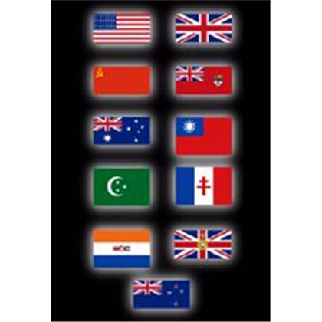
The Allies

Slide 26
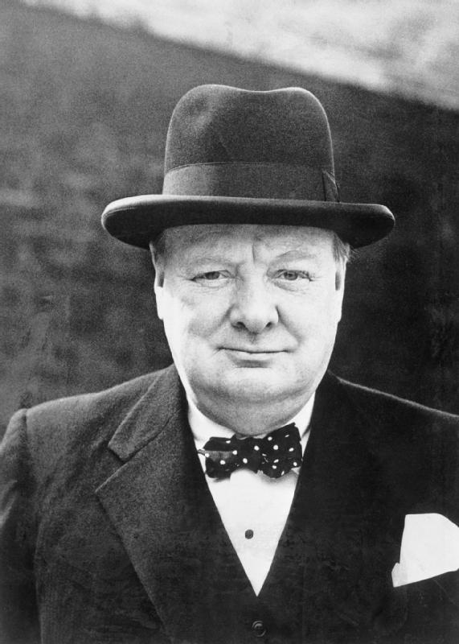
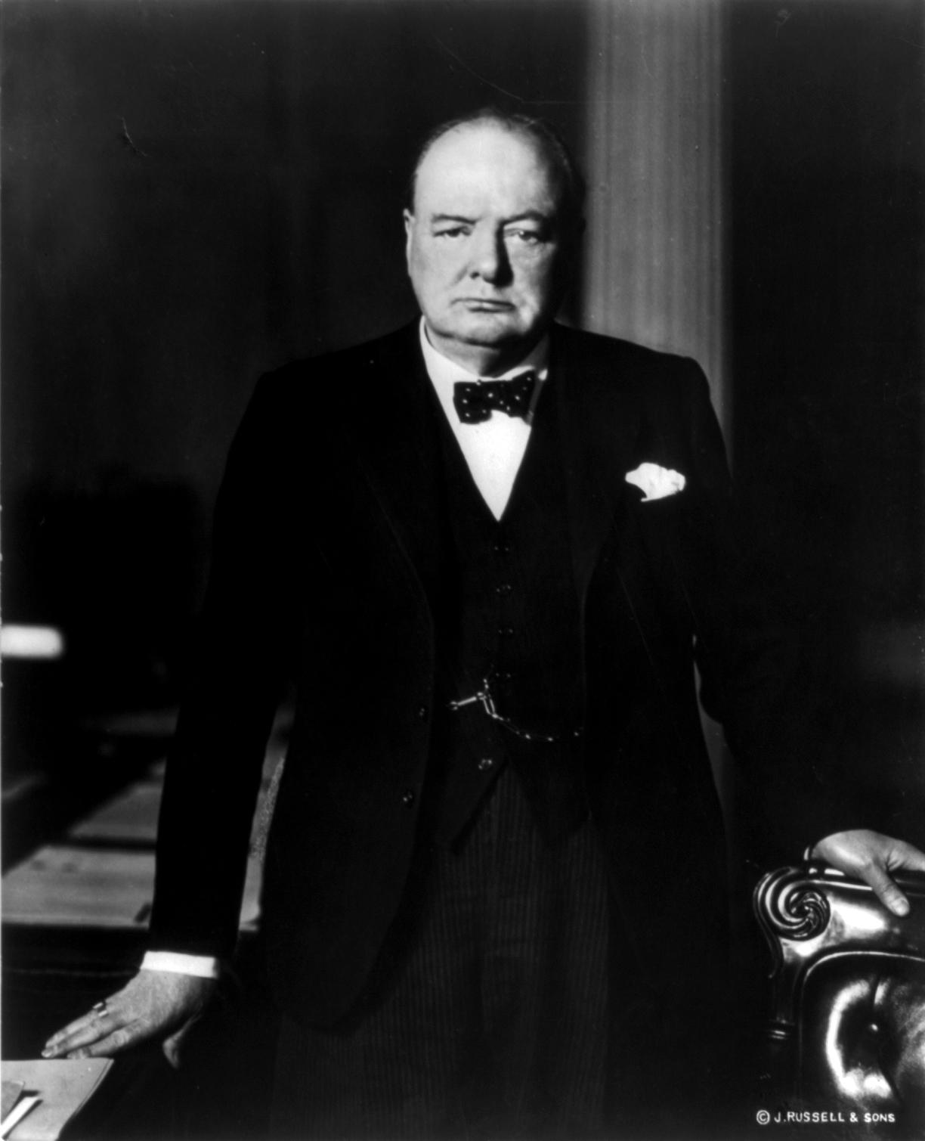

Slide 27
Winston Churchill
Great Britain (England, Ireland & Scotland)
1900-1950
British Prime Minister during WWII

Slide 28
Winston Churchill
First to declare was against Hitler after the invasion of Poland
Tries to help France after Nazi invasion but retreats to England with his soldiers
Keeps the country together even after Hitler bombs London
Known for his intelligence gathering skills

Slide 29
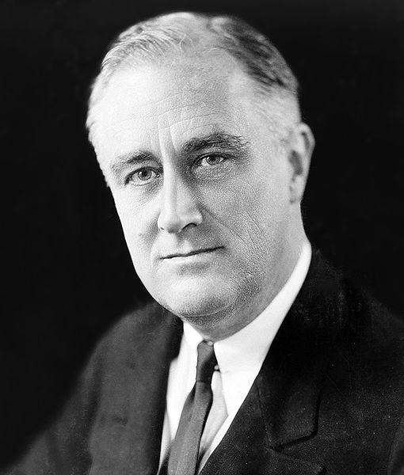

Slide 30
Franklin Delano Roosevelt (FDR)
US President 1932-1945
Only US president to serve more than two terms
Died in 1945 at the beginning of his fourth term

Slide 31
FDR
Helped America out of the Great Depression through his New Deal programs
Wanted to help his friends out in WWII so he signed the Lend-Lease Act
US gave our allies aid
Allies leased us land to put bases on in their countries

Slide 32
FDR
After two years of war in Europe, enters WWII when Pearl Harbor is attacked by Japan
Died before the end of the war

Slide 33
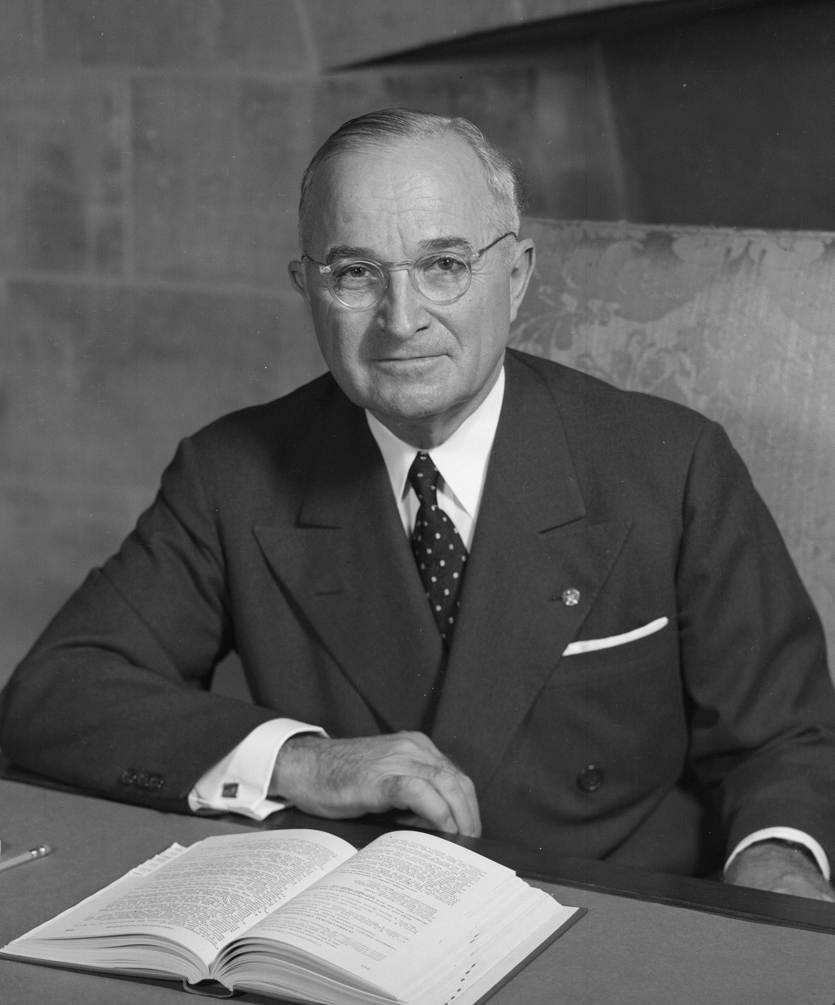

Slide 34
Harry Truman
April 12, 1945-1952
Was Vice President when FDR died
Re-elected for second term in 1948
Is the President that drops the atomic bombs on Hiroshima and Nagasaki

Slide 35
Harry Truman
Ends racial segregation in the military at the end of WWII
Truman Doctorine: we must give aid to countries so they don’t become communist
Helped America join NATO and actively contained communism in the U.S. and abroad

Slide 36
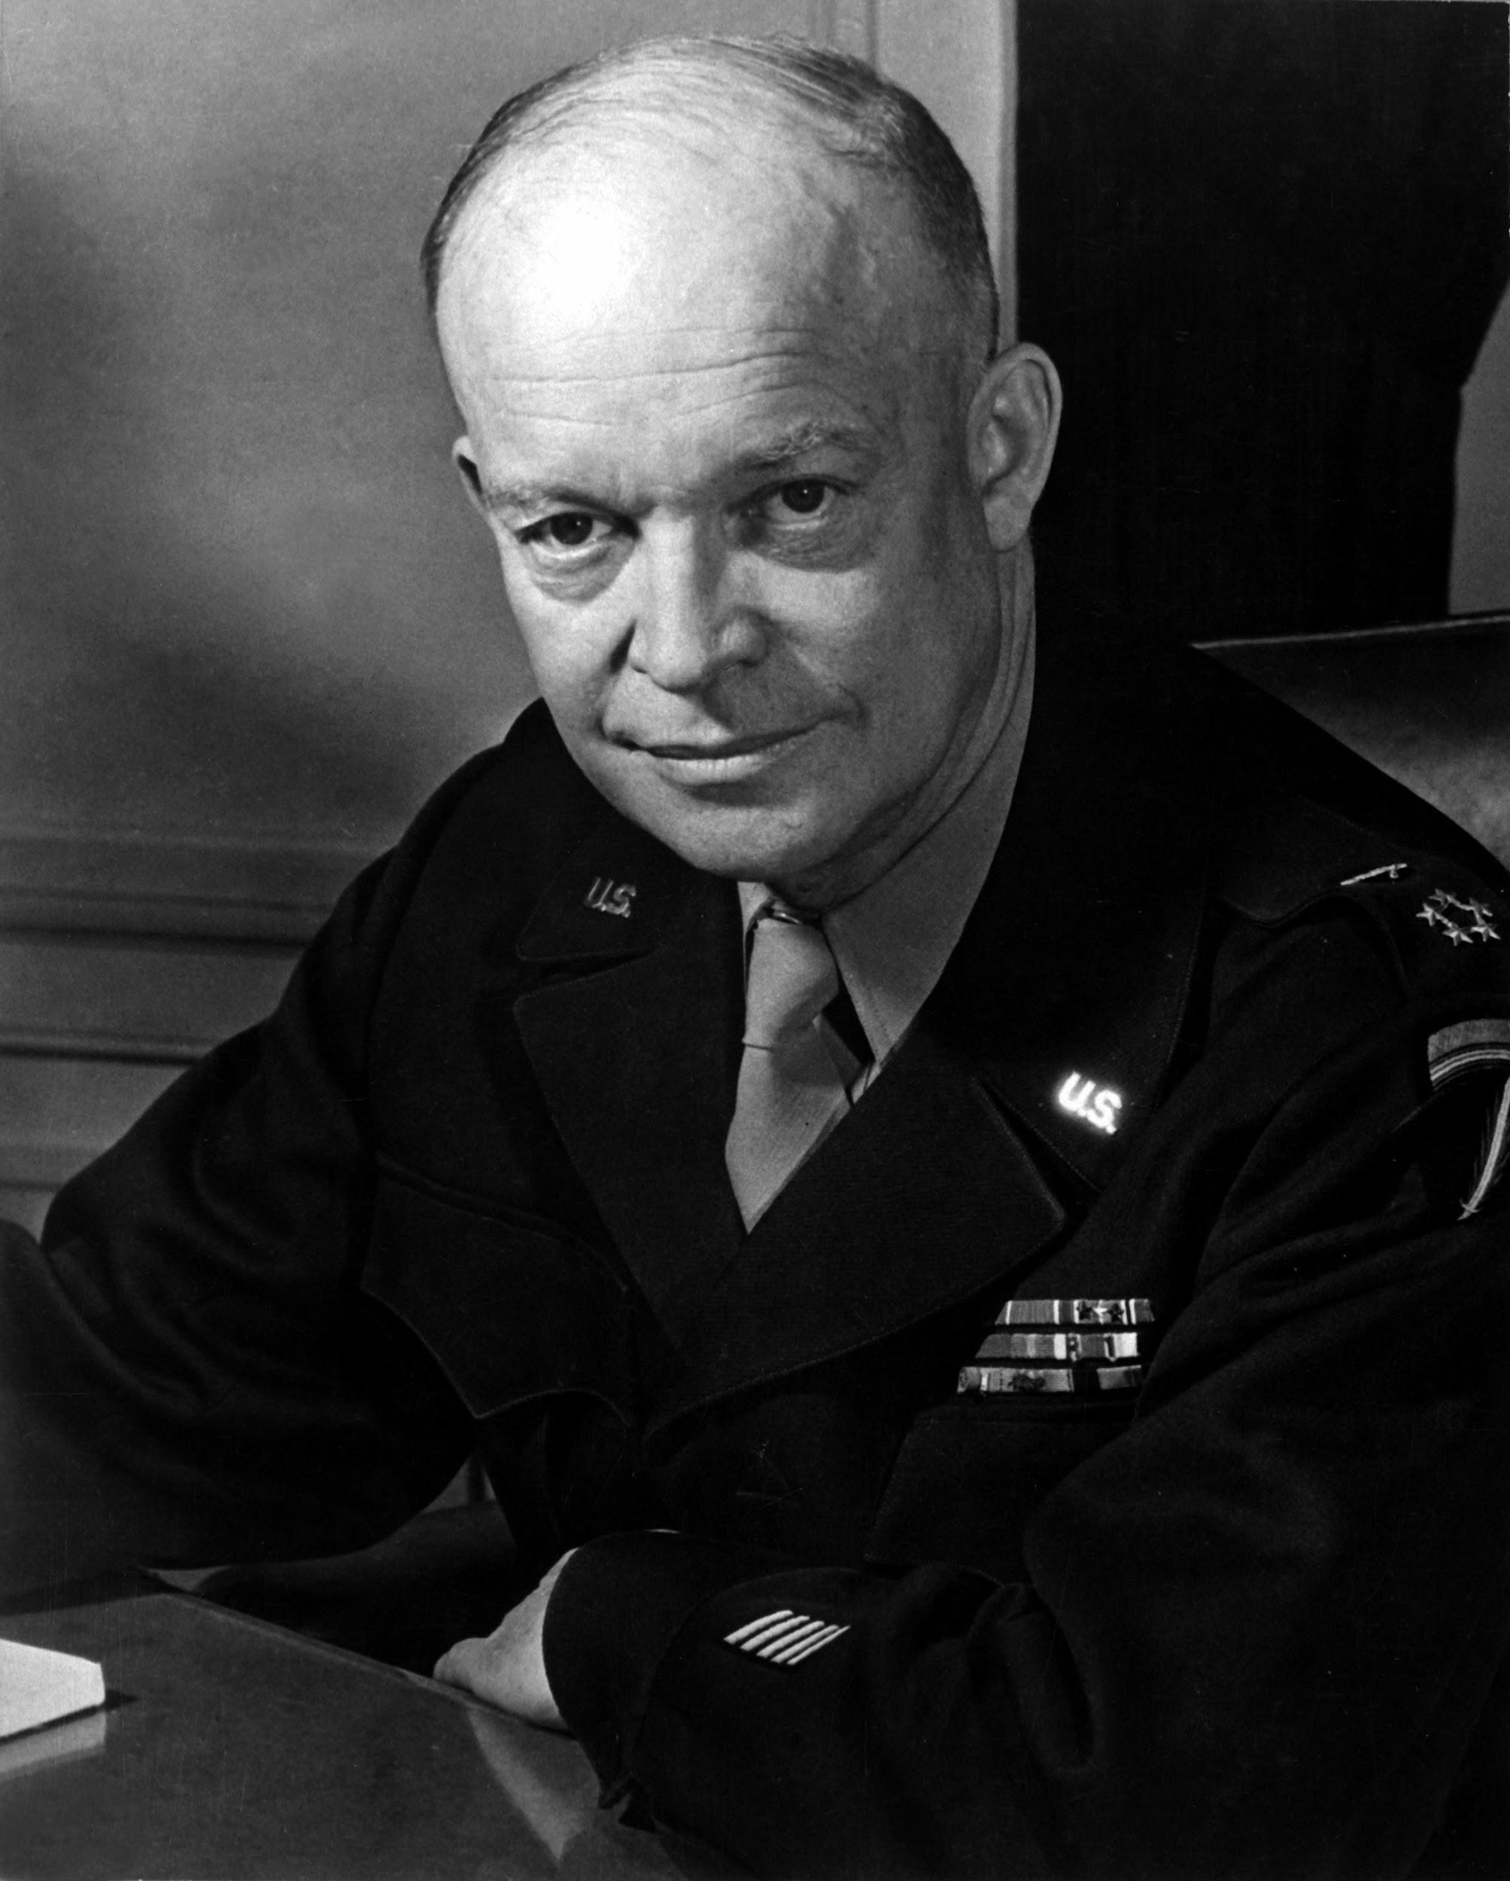

Slide 37
General Eisenhower
Supreme Commander of Allied forces in Europe
Planned the D-Day invasion
First commander of NATO
U.S. President from 1953-1960

Slide 38
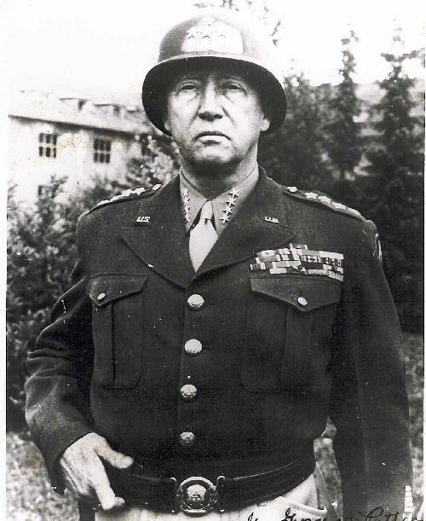
“We’re not just going to shoot the bastards, we’re going to cut out their living guts and use them to grease the treads of our tanks.”

Slide 39
General George Patton
Nicknamed “Old Blood and Guts”
Liberated Africa from Mussolini’s control
Helped win the war for the Allies in Europe
One of the most successful Genrals in American history
Died in 1945 in a minor car accident (some say he was assassinated)

Slide 40
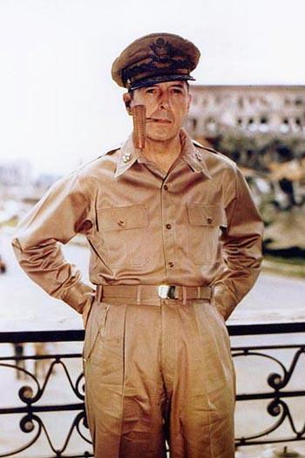

Slide 41
General Douglas MacArthur
Commander of U.S. Army in Asia
Retook the Philipines from the Japanese
Officially accepted Japan’s surrender at the end of the war
Became involved in the Korean War eight years after WWII

