Slide 1
Elections
How do they work?

Slide 2
Elections for President & Vice President happen every four years
The next election for President & VP will be in November 2016!!

Slide 3
Who Can Run For President?
Must be at least 35 years old
Must be a native-born citizen of the U.S.
Must have lived in the U.S. for the past 14 years
Can be a man or woman
Can be any religion
Can be any sexual orientation

Slide 4
Once A Person Decides To Run For President They Must…...
Decide what political party they belong to
What platform, or issues, they will focus on the most
Create campaign strategies
Fundraise to acquire funds for campaigning

Slide 5
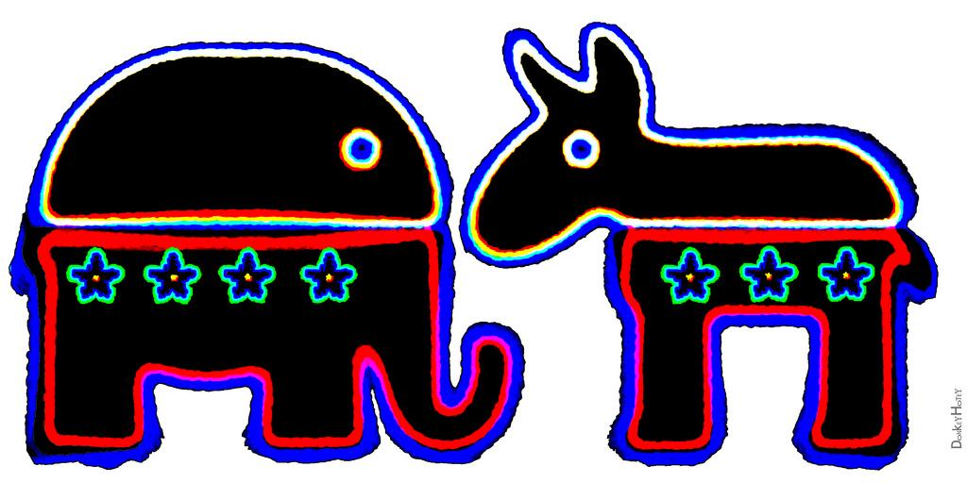

Slide 6
Political Campaigns
A political campaign is the process of a candidate conveying to the public what they are all about
Candidate tries to convince voters why they should vote for him/her
Usually costs a lot of money to travel around the country, put commercials on tv, etc.

Slide 7
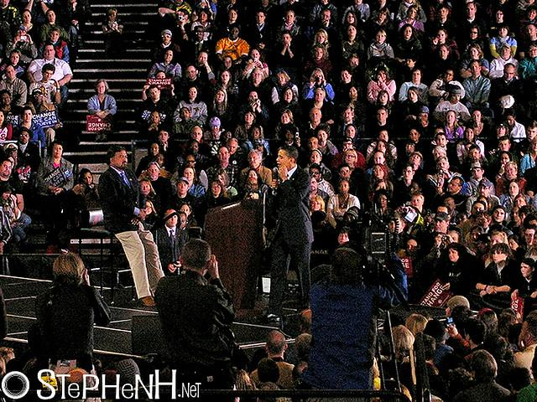
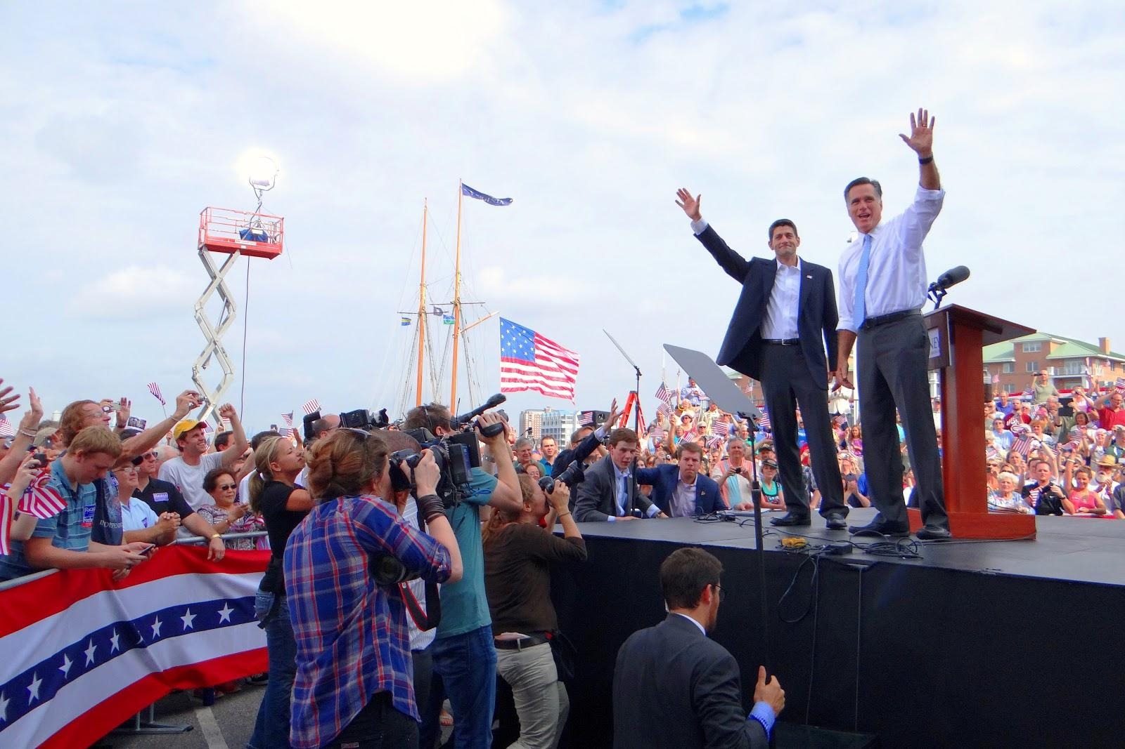

Slide 8
Primary Elections
Primary elections are the first step in which voters dwindle down the numerous amount of candidates into one candidate for each political party
Whoever wins the primaries gets to represent their political party in the final election

Slide 9
Political Party Conventions
Each political party has a convention which is a huge party
The winner of the primary election is revealed and promoted as their party’s candidate for President
A chance for all party members to come together to discuss upcoming platform issues

Slide 10
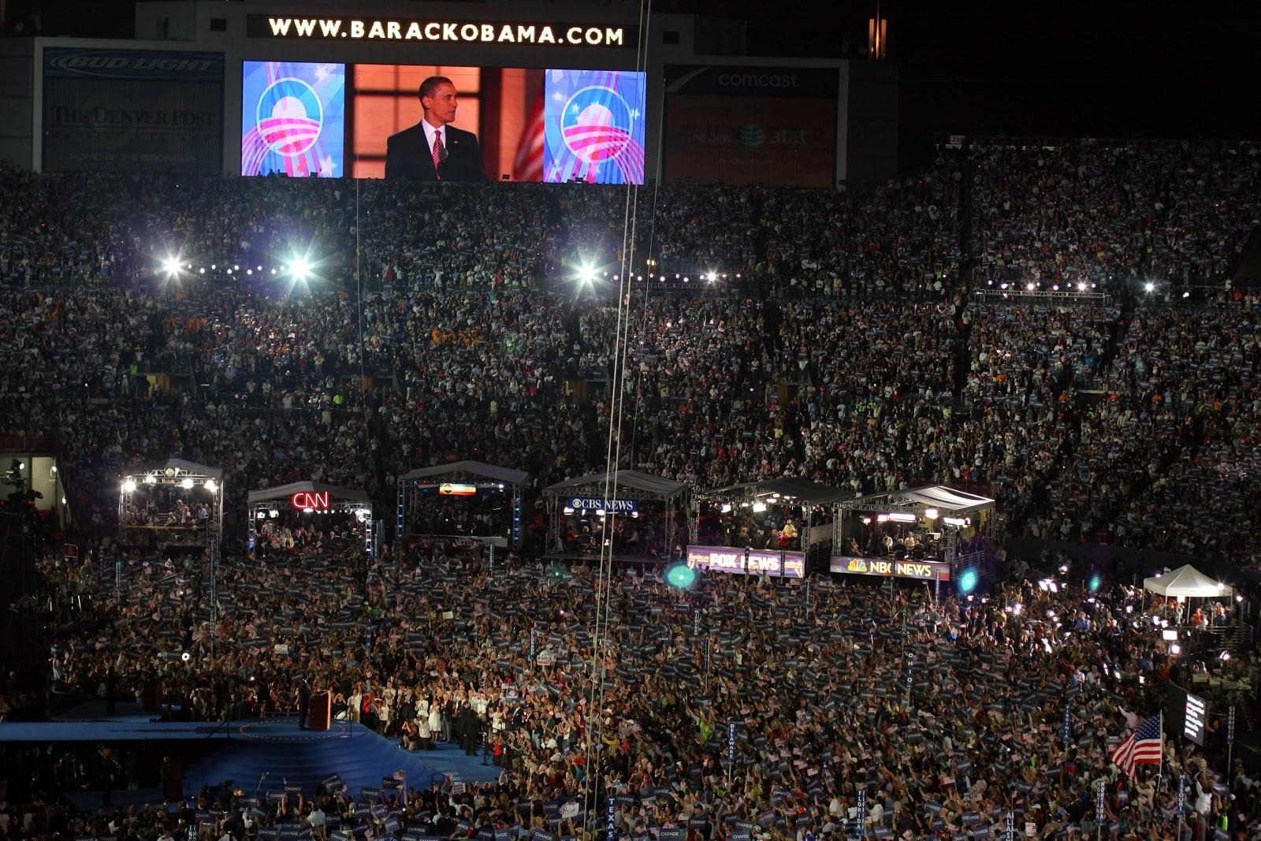

Slide 11
1968 Democratic Convention Protest

Slide 12
2008 Republican National Convention Protest

Slide 13
Presidential Debates
The candidate from each political party come together to discuss what they will do if they become President
Usually only Democratic & Republican party candidates are allowed in the debates
Gives the voters a better idea of what each candidate is about so they can be more informed to make a decision on who to vote for

Slide 14
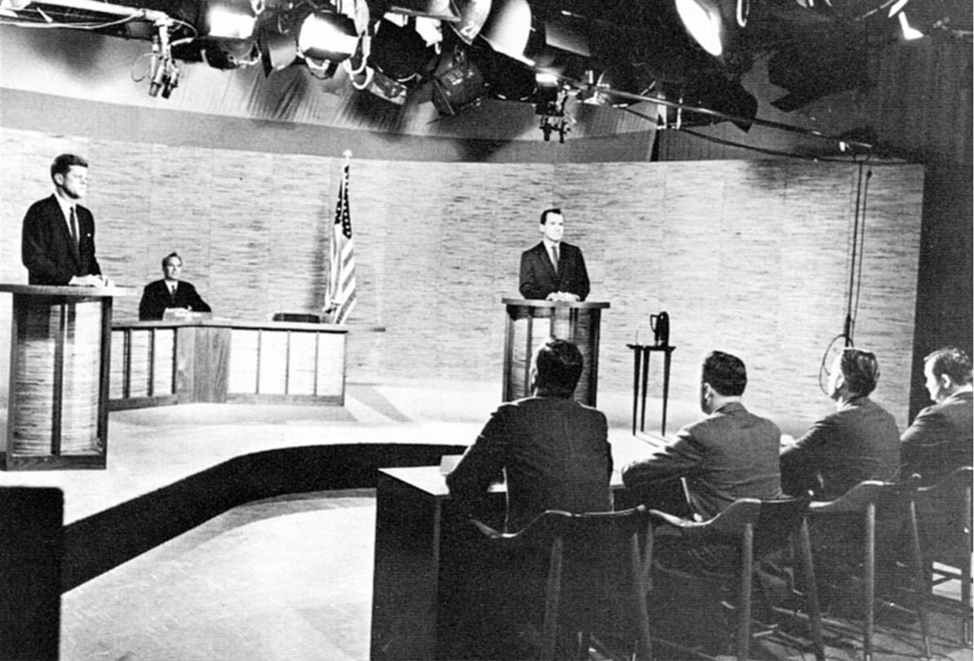
The 1st televised Presidential debate was between JDK & Nixon
Nixon

Slide 15
Voting
Elections are held on the Tuesday after the first Monday in November
American citizens cast their ballots in polling stations with either paper or electronic ballots
Voters can also mail in their ballots in some states
Results from each state are posted on T.V. news shows as they come in

Slide 16
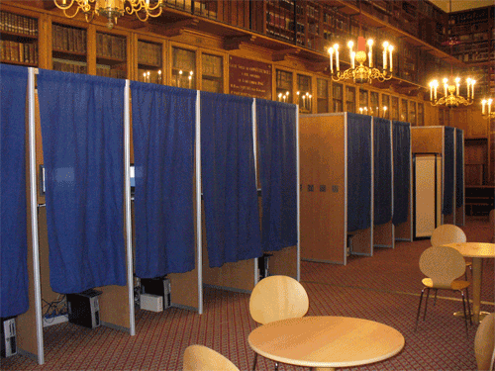
Voting Booths

Slide 17
Electoral College Electors Vote
Electors in each state are chosen by political parties
The number of electors each state has is the number of representatives they have in the House of Representatives + how many Senators they have
Arizona has 11 House Reps & 2 Senators so we have 13 electors in the Electoral College

Slide 18
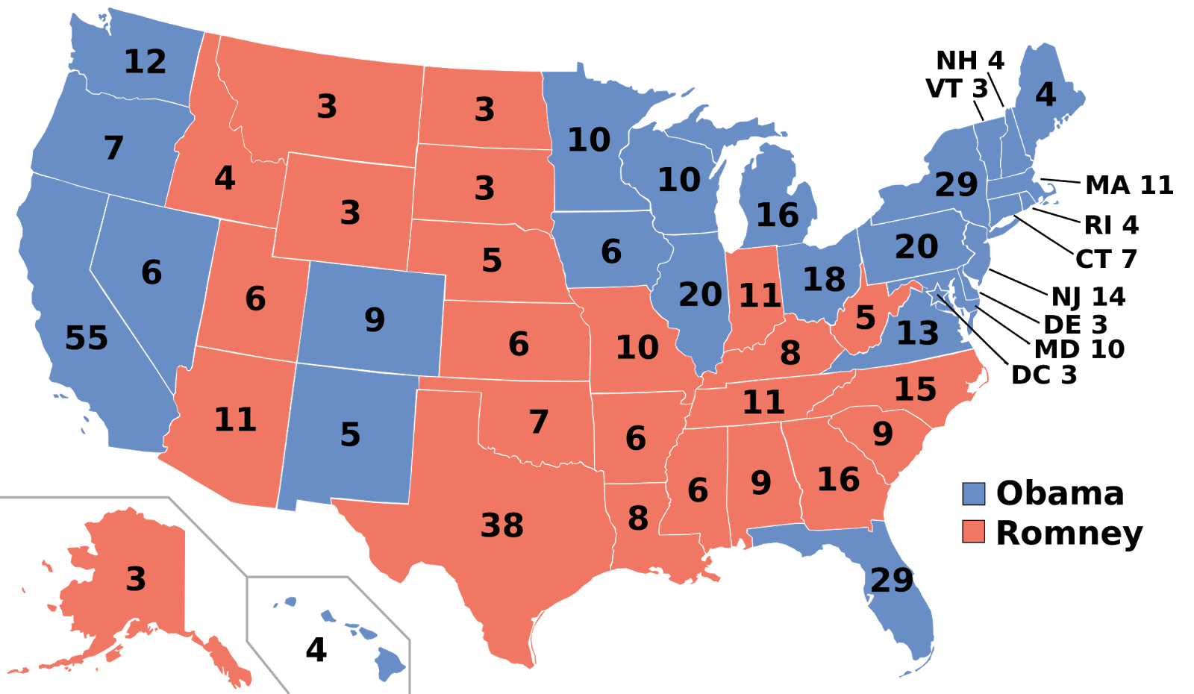

Slide 19
Electoral College
So the states with the most people have more representatives and therefore more electoral votes.
This means states like California and New York have a huge influence on how elections will turn out.

Slide 20
Electoral College vs Popular Vote
Popular vote is how citizens vote
Electoral college votes can be different than the popular vote
This means someone can become President even though the majority of Americans did not vote for him/her
This happened in 1824 (Andrew Jackson), 1876 (Rutherford B Hayes), 1888 (Benjamin Harrison) & 2000 (George W Bush)

Slide 21
Inauguration
The President is inaugurated, or introduced officially, on January 20th
He/she gives their inaugural speech stating what they plan to do as President
He/she takes an oath to fullfill the duties as President

Slide 22
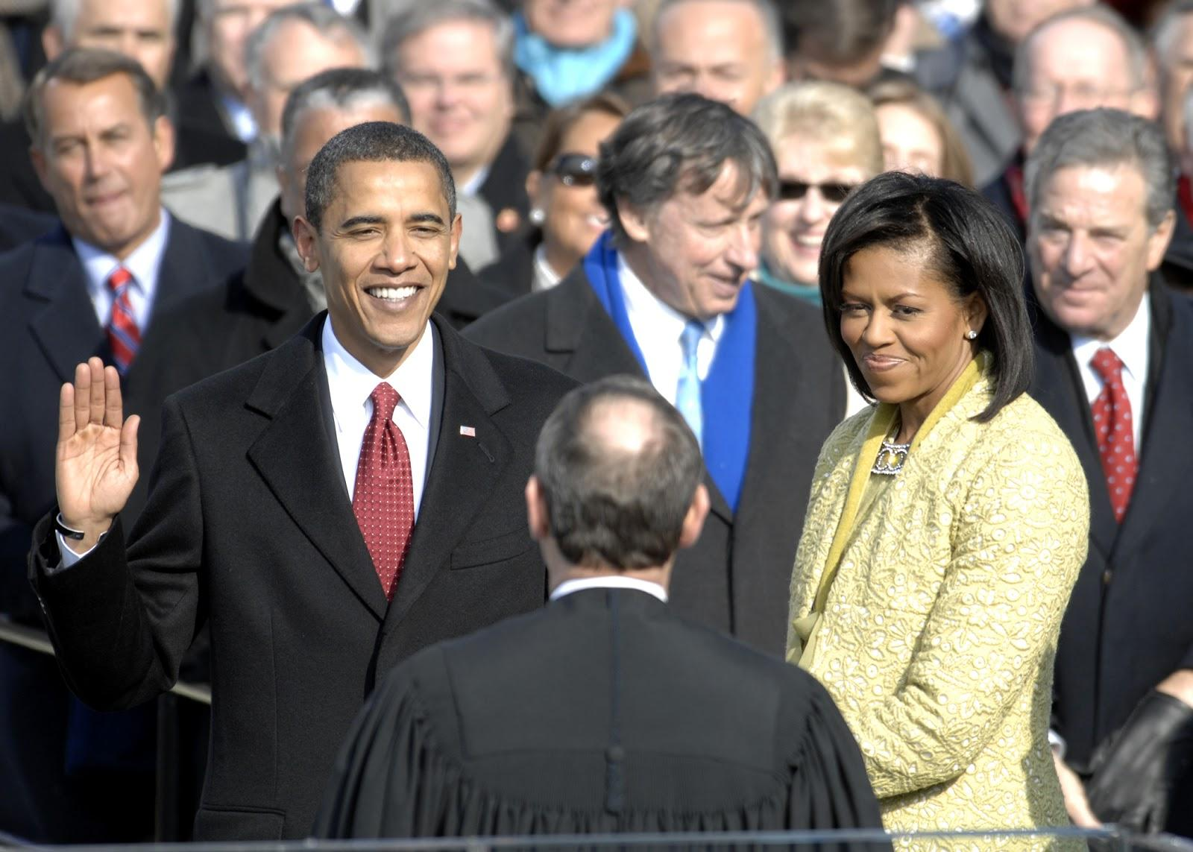

Slide 23
Inaugural Oath
“I do solemnly swear (or affirm) that I will faithfully execute the office of President of the United States, and will to the best of my ability, preserve, protect, and defend the Constitution of the United States.”

